Slide 1

REMAKE.COM
Transforming designs into products

Slide 2

Team
Contents
Abouts Us
Requirement Analysis (SRS)
Database Design
Technology Used
Final Product Features
Akshay Rettapali, Pranav Mallick, Rakesh Kumar, Shivam Navthar, Shrenik Badjate

Slide 3

About Us
The purpose of the site
We are a fashion website where you can purchase for your wardrobe
Unique Designs
E-commerce platform
Scalable and simple
TREY research

Slide 4

Software Requirements Specifications
Includes functional and non-functional requirements.

Slide 5
Requirements
Sign up page
Login Page
Cart
Product Display Page
About Us
Help Desk

Slide 6
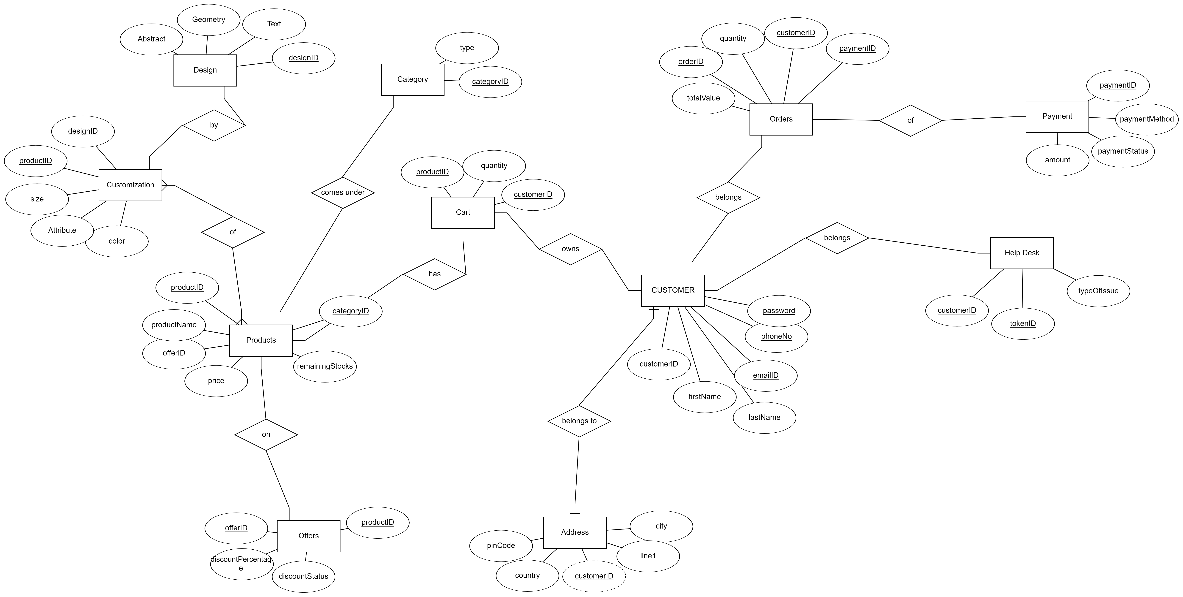
Database Design
ER Diagram

Slide 7
Technology Used
Libraries, Frameworks, and tools.
Backend
Web
Spring Boot
Spring Boot JPA
Thym Leaf
MySQL Connector
Java
Spring Security
HTML5
CSS
Javascript
Tomcat Server

Slide 8

Website Demo
Remake.com

Slide 9
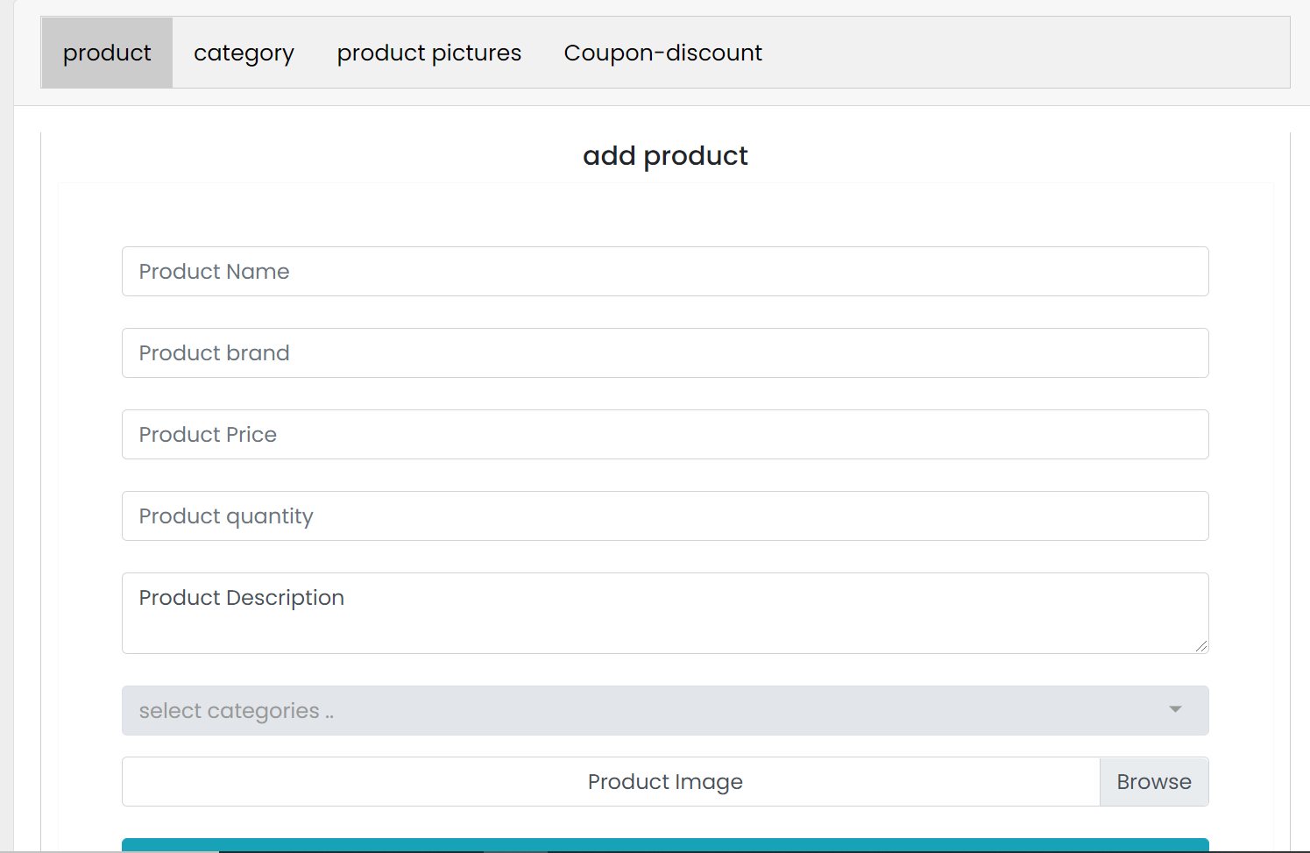
Add Product Page
Remake.com

Slide 10
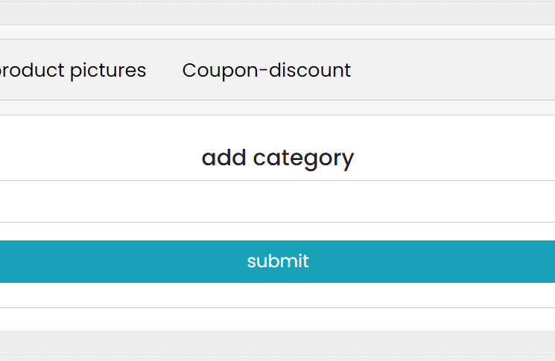
Category
Remanke.com

Slide 11
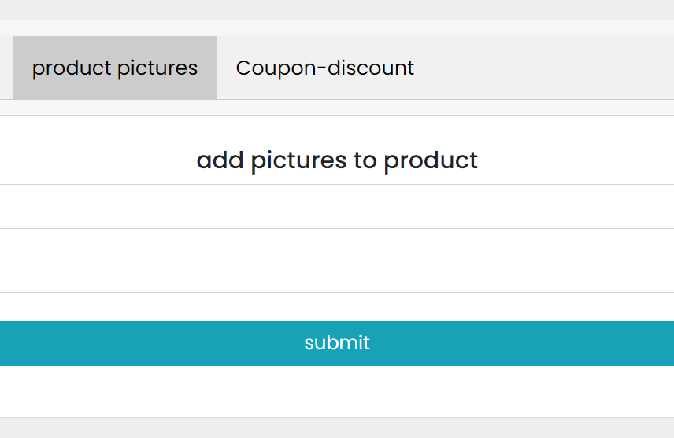
Product
Remanke.com

Slide 12
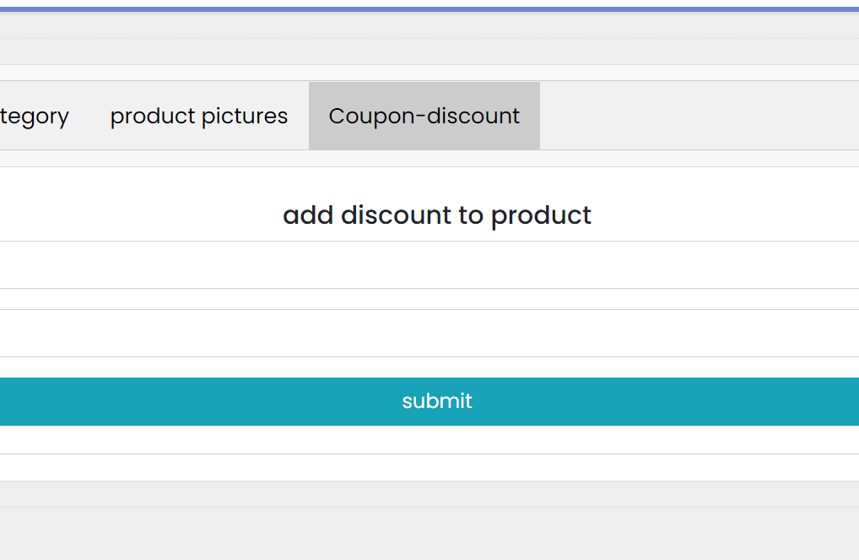
Discount
Remanke.com

Slide 13

Thank You

